Slide 1
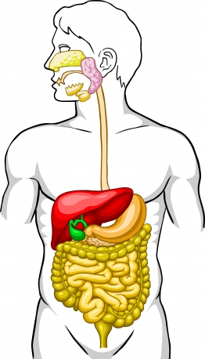
The digestive system

Slide 2
WALT:
Remember the structure of the digestive system facilitates the breakdown of food to compounds that can be readily absorbed into the blood for use in the cells

Slide 3
Digestion
Purpose:
Break food into smaller parts so that they can be absorbed and used by the body.
This can be done by Mechanical or Chemical digestion

Slide 4
WALT:
Understand that mechanical digestion, including the teeth and peristalsis, is required to reduce the size of food pieces and to increase the surface area on which chemical digestion can act

Slide 5
Mechanical Digestion
Mechanical digestion is the physical action of body tissues and organs to aid in the breaking food into smaller pieces.
This can happen in the:
Mouth
Stomach
Small intestine

Slide 6
WALT:
Understand that chemical digestion involves the use of enzymes (amylase, protease and lipase) to chemically break down food for absorption

Slide 7
Chemical Digestion
Chemical digestion is the process of using chemical reactions to break food into smaller pieces.
This can happen in the:
Mouth
Stomach
Small intestine

Slide 8
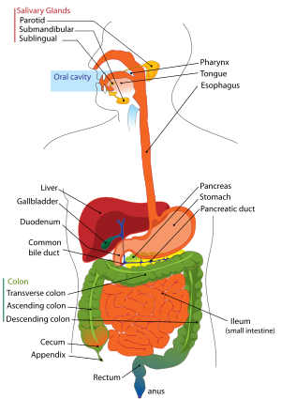
Structure of the Digestive System

Slide 9
The Mouth
The mouth is involved in:
Chewing
Bolus formation
Swallowing
Enzyme action (amylase)

Slide 10
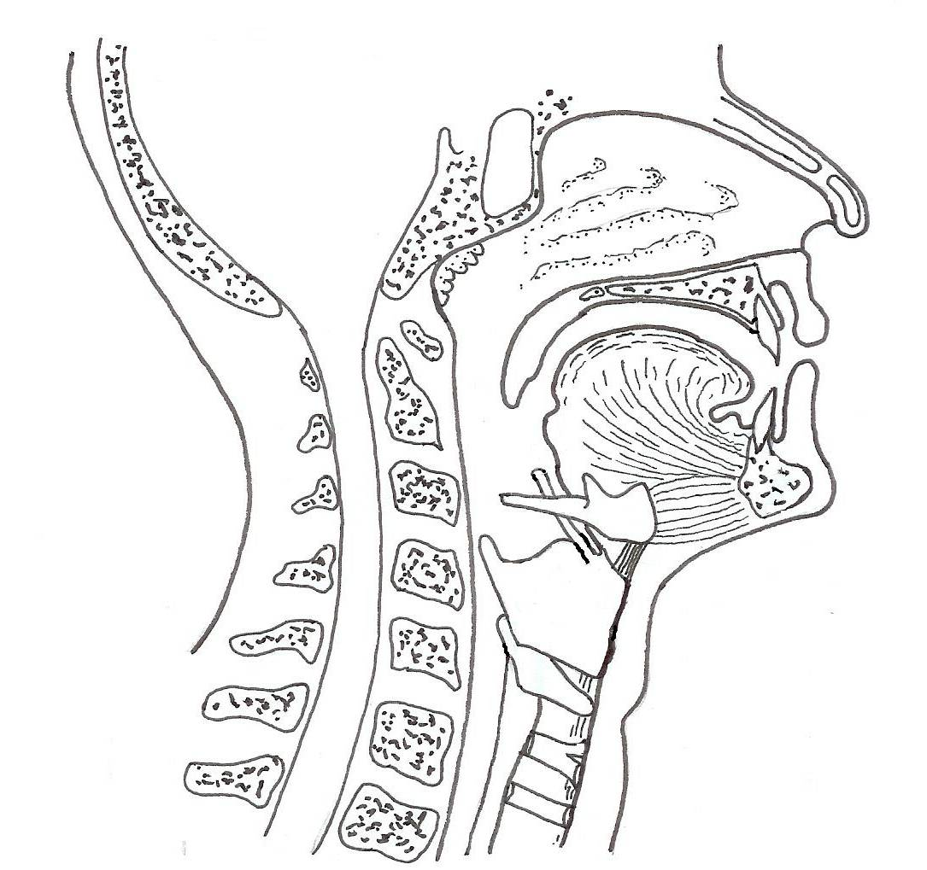
Section through the head

Slide 11
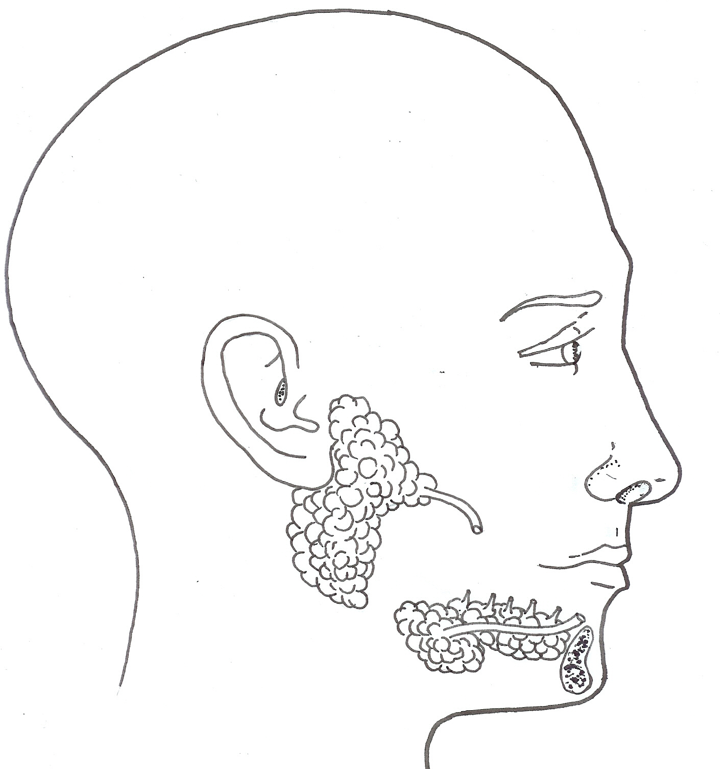
The salivary glands

Slide 12
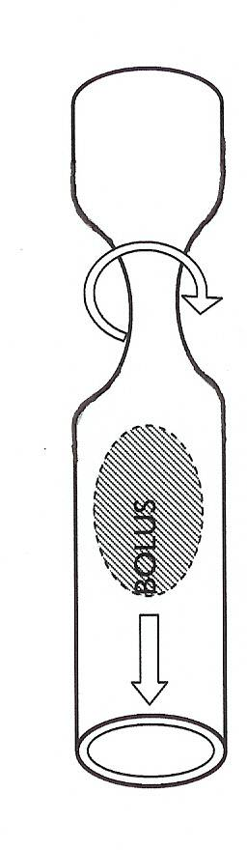
OESOPHAGUS
Has circular and longitudinal muscles.
Peristalsis (contraction of muscles) pushes the bolus (food) down the oesophagus to the stomach.
Bolus

Slide 13
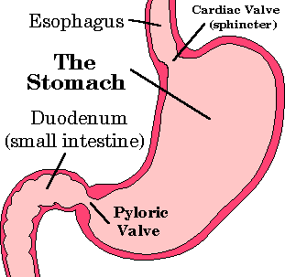
The stomach
Muscular churning (mechanical digestion) mixes food with gastric juice (forms chyme)

Slide 14
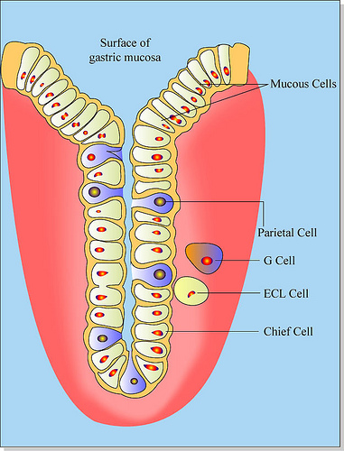
Gastric Juice
Gastric juice released by gastric glands in wall of stomach.
Gastric juice contains HCl, mucus and enzymes

Slide 15
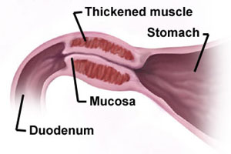
Chyme
The pyloric sphincter is a circular muscle. It constricts to prevent food (chyme) from continuously entering the small intestine.
Every 2 – 8 hours the sphincter allows chyme to be pushed into the Duodenum.

Slide 16
Absorption in the stomach
Due to the thick mucus layer most nutrients are not absorbed through the stomach.
There is limited absorption of:
water, glucose, alcohol and some drugs

Slide 17
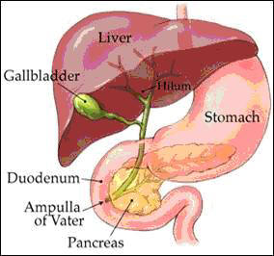
Small Intestine
Duodenum
First part of the small intestine.
Chemical digestion continues with:
Amylase, Bile from the liver, protease and Lipase

Slide 18
Absorption
Chemical digestion continues while food moves down the small intestine.
Absorption of the small digested particles occurs through the intestinal wall.
Small intestine is approx. 6 metres long to increase surface area.
Lined with folded Villi and Microvilli to further increase surface area.

Slide 19
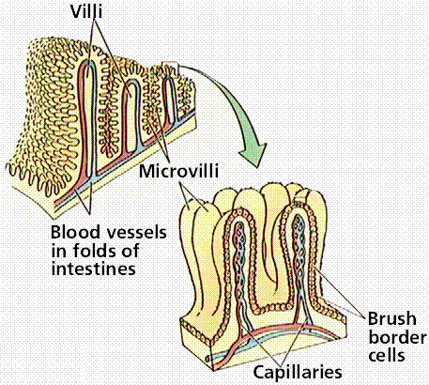
Capillaries absorb simple sugars, amino acids, water and water soluble vitamins. Taken by hepatic portal vein to liver

Slide 20
Large intestine
Function:
Further absorption of water and some salts
Bacterial activity
There are trillions of bacteria in the large intestine (several important roles including the digestion of cellulose)
It may take 18 – 24 hours for food to pass through the large intestine.

Slide 21
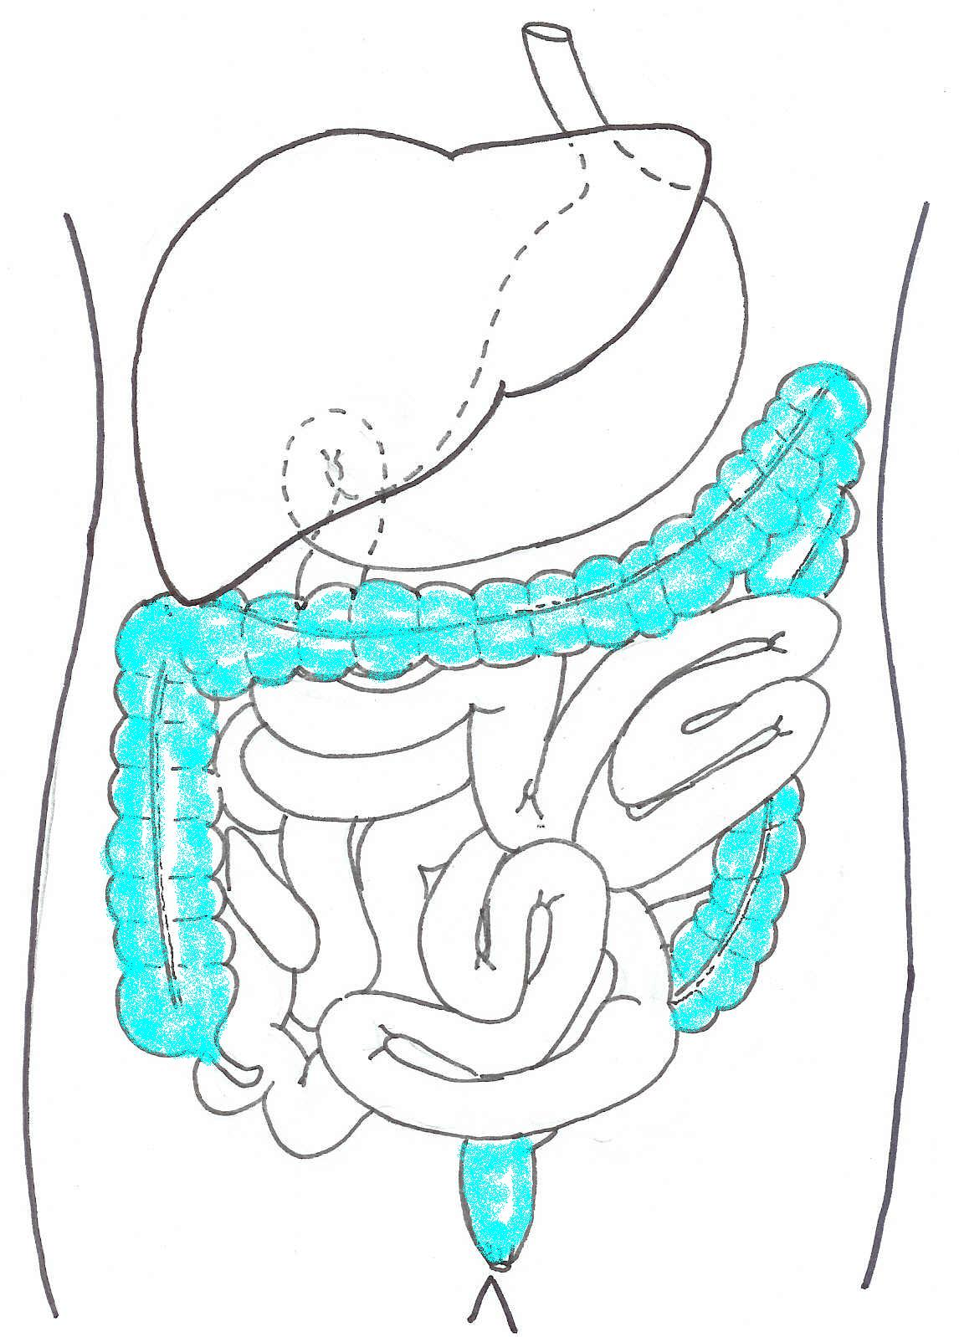
The large intestine
LIVER
Colon
(transverse branch)
Colon
(ascending branch)
Caecum
Colon
(descending branch)
Appendix
Rectum

Slide 22
WALT:
Remember that the materials eliminated from the digestive system include indigestible contents, excess materials and some metabolic wastes

Slide 23
Elimination of Faeces
Faeces contains:
Water
Undigested food
Bacteria
Bile
Remains of dead cells from the intestinal lining.

Slide 24
WALT:
Understand the function of the digestive system can be compromised by diseases and conditions that reduce the efficiency of digestion or absorption of food

Slide 25
Conditions and Diseases of the alimentary canal (digestive system)
Constipation
Diarrhoea
Bowel cancer
Coeliac disease

